Slide 1
CS325 Project 4.3
Studio Presentation
Michelle K, Jaeseong L, Cici C, Foroogh H

Slide 2
The Need and Main Idea
KE result:
“UMass 5 college students do not have access to a user friendly rideshare application in comparison to applications like Uber and Lyft”
Main Need
Easy and convenient rideshare platform.
Facebook page | Uber/Lyft
Not designed around the needs of ride-share platform Booking; Ratings; Payments; maps; etc Not user friendly | Reservation Novice users spend long to figure it out

Slide 3
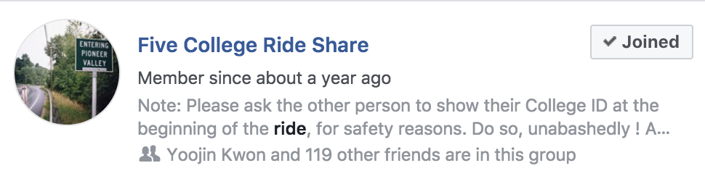

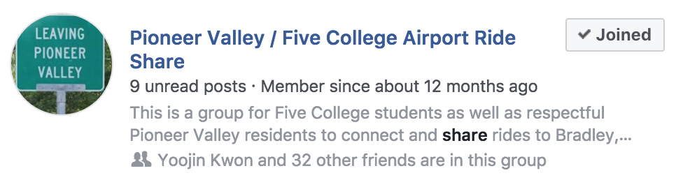

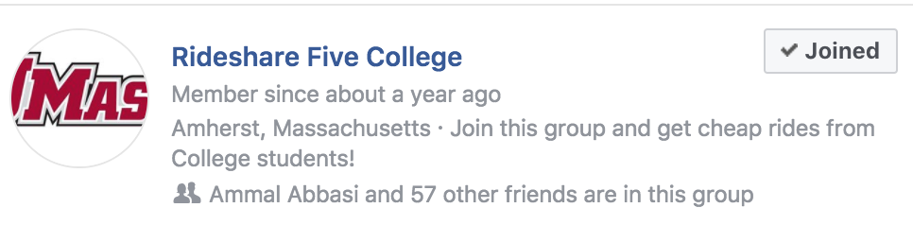
Existing Approaches
Filter
Ranking system
Matching system
Live updates
No ride reservation ( for Uber/Lyft)
Manually search through posts to meet needs and ask for updates about rides
Needless similar Facebook group

Slide 4
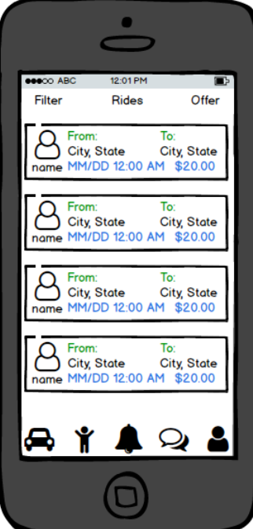
APPROACH
Creating user profile (name, age, affiliated 5 college school, profile pic and an optional description (ex. precautions).
Posting (to request/offer rides) Source/Destination/Date/Time - filter function
Notification(for upcoming trip / matching offer)
In app messanger/caller
Rating system

Slide 5
Representative Tasks
Easy:
Communication through in-app messaging and calling
Medium-Difficulty:
Creating a profile
Difficult:
Creating post
Notes:
Easy: Between passenger and driver; usability: get additional info best gained through direct communication
Medium-Difficulty: input email, name, age, school, picture, optional description w/ additional info about user (allergies, humanizes them)
Difficult: Creating request or offer for ride

Slide 6
Questions??????????

